Slide 1
CSC 2224:
Parallel Computer Architecture and Programming
Prof. Gennady Pekhimenko
University of Toronto
Fall 2020
The content of this lecture is adapted from the lectures of
Onur Mutlu, Hadi Esmaeilzadeh, and Samira Khan

Slide 2
Summary
Syllabus
  Course Introduction, Logistics, Grading
Information Sheet
  Getting to know each other
Paper Reviews and Presentation
  How to handle these beasts
Project
  Team formation, Proposal, Milestones
And Some Technical Details

Slide 3
Syllabus: Who Are We?

Slide 4
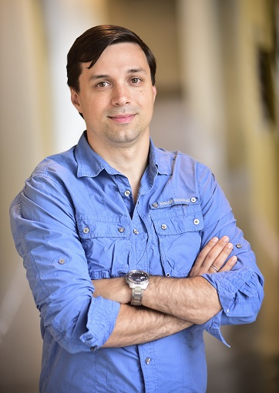

Gennady (Gena) Pekhimenko
Assistant Professor, Instructor
pekhimenko@cs.toronto.edu
http://www.cs.toronto.edu/~pekhimenko/
Office: BA 5232
PhD from Carnegie Mellon
Worked at Microsoft Research, Nvidia, IBM
Research interests: computer architecture, systems, machine learning, compilers, hardware acceleration, bioinformatics
Computer Systems and Networking Group (CSNG)
EcoSystem Group

Slide 5

Hossein Farrokhbakht
PhD Student in ECE, TA
h.farrokhbakht@mail.utoronto.ca
Research interests: computer architecture and
interconnection network
Computer Systems and Networking Group (CSNG)
EcoSystem Group

Slide 6
Course Information: Where to Get?
Course Website: https://csc2224.github.io/
  Announcements, Syllabus, Course Info, Lecture Notes, Reading List and Reviews, Project Information
Piazza: https://piazza.com/class/ken2hxl981f27u
  Questions/Discussions, Syllabus, Searching for Teammates
Your email

Slide 7
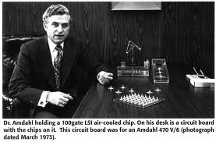
What is Computer Architecture?
Computer Architecture:
The science and art of designing, selecting, and interconnecting hardware components and designing the hardware/software interface to create a computing system that meets functional, performance, energy consumption, cost, and other specific goals.
Traditional definition:
The term architecture is used here to describe the attributes of a system as seen by the programmer, i.e., the conceptual structure and functional behavior as distinct from the organization of the dataflow and controls, the logic design, and the physical implementation.” Gene Amdahl, IBM Journal of R&D, April 1964

Slide 8

Level of Transformations
Problem
Operating System
Interface between Software and Hardware
Architecture
Circuits

Slide 9
The Power of Abstraction
Isolation
  A higher level only needs to know about the interface to the lower level, not how the lower level is implemented
  For example, high-level language programmer does not really need to know about the architecture
Productivity
  No need to worry about decisions made in underlying levels
  For example, programming in Java vs. C vs. assembly vs. binary vs. by specifying control signals of each transistor every cycle

Slide 10
Crossing the Abstraction Layers
Should we always focus on our own layer?
As long as everything goes well, not knowing what happens in the underlying level (or above) is not a problem
What if
  One of the layers reach a limit, there is no way to improve
  There is a new disruptive change in technology that cannot be contained in a layer
  New Applications that are too slow for today’s system

Slide 11
Scope of this Course
Broad view of processor and memory design
  Beyond the ISA+microarchitecture levels
  E.g., system-architecture interfaces and interactions
  E.g., application-architecture interfaces and interactions
Out-of-the-box thinking is greatly encouraged
  E.g., research projects and readings on architectures that challenge the current dominant paradigms
    processing in memory, approximate systems, persistent memory, neuromorphic computing, …
  E.g., readings on topics that are traditionally covered less in computer architecture courses

Slide 12
What Will You Learn?
Hardware/software interface, major components, and programming models of a modern computing platform
  State-of-the-art as well as research proposals (lots of them)
  Tradeoffs and how to make them
  Emphasis on cutting-edge (research & state-of-the-art)
Hands-on research in a computer architecture topic
  Semester-long research project
  Focus: How to design better architectures (not an intro course)
Broaden your research vision
  Will read papers not only from computer architecture
  But, possibly, from circuits, programming language, operating systems, graphics, networking, …

Slide 13
Course Goals
Goal 1: Rethink and redesign our computing model focusing on minimizing data movement and storage
  Understand the importance of cross layer research
  Gain new insight from VLSI circuits, architecture design, systems, programming languages, and new application domains
  Strong emphasis on critical analysis of research papers (through reading and literature review assignments)
Goal 2: To provide the necessary background and experience to advance the state-of-the-art in computer architecture by performing cutting-edge research
  Strong emphasis on developing new mechanisms that advance the state-of-the-art (through the course research project)

Slide 14
Advanced Graduate-Level Class
Required background:
  basic architecture
  basic compilers
  basic OS
  programming skills
  spirit, excitement, and dedication for deep exploration of a topic in computer architecture

Slide 15
CSC 2224: Parallel Computer Architecture and Programming
Grading, Policies, Course Work
Prof. Gennady Pekhimenko
University of Toronto
Fall 2020

Slide 16
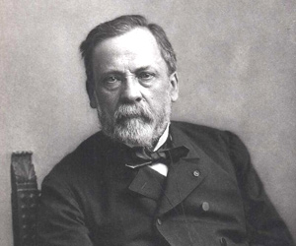
What Do I Expect from You?
Work hard
Ask questions, think critically, participate in discussion
Critically review the assigned research papers & readings
  Discuss/critique them online with peers and us
Use Piazza and Write good reviews
Start the research project early and focus
Remember “Chance favors the prepared
mind.” (Pasteur)

Slide 17
Course Work
Project (50%):
  Groups of 2, sometimes 3
  Proposal, Progress Report, Final Presentation and Final Report
  Scaled down version of the real research projects
Paper Reviews (20%):
  1-2 papers per week
  3-4 paragraphs

Slide 18
Course Work (2)
Paper Presentation (20%):
  Related works in your project area
Class Participation (10%)
  Very important

Slide 19
Grading
Grading will be back-end heavy
Most of your grade will be determined late
  How you prepare and manage your time is important
  But grades should not be the reason for taking this course

Slide 20
Paper Review: How to Handle
Brief summary
  What is the problem the paper is trying to solve?
  What are the key ideas of the paper? Key insights?
  What is the key contribution to literature at the time it was written?
  What are the most important things you take out from it?
Strengths (most important ones)
  Does the paper solve the problem well?

Slide 21
Paper Reviews (2)
3. Weaknesses (most important ones)
  This is where you should think critically. Every paper/idea has a weakness. This does not mean the paper is necessarily bad. It means there is room for improvement and future research can accomplish this.
4. Can you do (much) better? Present your thoughts/ideas.
5. What have you learned/enjoyed/disliked in the paper? Why?
Review should be short and concise (~ ½ a page to 1 page maximum)

Slide 22
Advice on Reviewing
When doing the reviews, be very critical
Always think about better ways of solving the problem or related problems
Do background reading
  Reviewing a paper/talk is the best way of learning about a research problem/topic
Think about forming a literature survey topic or a research proposal based on the paper (for future studies)

Slide 23
How to Submit?
Email PDF with your review to csc2224arch@gmail.com
Due Thursday 1pm each week
Next week: “Dark Silicon and the End of Multicore Scaling”, Hadi Esmaeilzadeh, ISCA 2011.

Slide 24
Research Project
Your chance to explore in depth a computer architecture topic that interests you
Perhaps even publish your innovation in a top computer architecture/systems/ML conference
Start thinking about your project topic from now!
Interact with me and Bojian
Use Piazza to discuss ideas, form teams based on interests, research areas

Slide 25
Research Project (2)
Goal: Develop (new) insight
  Solve a problem in a new way or evaluate/analyze systems/ideas
  Type 1:
    Develop new ideas to solve an important problem
    Rigorously evaluate the benefits and limitations of the ideas
  Type 2:
    Derive insight from rigorous analysis and understanding of existing systems or previously proposed ideas
    Propose potential new solutions based on the new insight
The problem and ideas need to be concrete
Problem and goals need to be very clear

Slide 26
Research Proposal: Key Questions
What is the problem?
Why is it hard?
How is it solved today?
What is the new technical idea?
Why can we succeed now?
What is the impact if successful?
http://en.wikipedia.org/wiki/George_H._Heilmeier

Slide 27
Where to Get Ideas?
Read a lot of papers; find focused problem areas to survey papers on
We will provide some ideas for projects
A good way of finding topics to survey or do projects on is:
  Examining the provided project ideas and papers
  Reading assigned papers in lectures and related/followup work
  Examining papers from recent conferences (ISCA, MICRO, HPCA, ASPLOS, …, SysML)

Slide 28
Project: Major Milestones
Project Proposal (1–2 pages) - Oct. 1st
Progress Report (2–3 pages) - Nov. 5th
Poster Presentation - Dec. 3rd (tentative)
Project Report (6–8 pages) - Dec. 10th

Slide 29
Presentation
After the project topic is selected, identify the key related works (1-3 papers)
Signup for the day to present your related work (25-30 minutes)
The exact schedule of the talks will be posted after project groups are formed

Slide 30
Presentation: What to Cover
Summary of the Work
  Problem, key ideas or insights, detailed mechanisms, and results
Strengths and Weaknesses
  Detailed discussion on both sides
Discussion
  Future research directions
  Alternative ways of solving the problem
  Importance of the problem
  Anything interesting about the research direction
  What did you like? What did you not like?

Slide 31
CSC 2224: Parallel Computer Architecture and Programming
Why Computer Architecture Matters
Prof. Gennady Pekhimenko
University of Toronto
Fall 2020

Slide 32




What has made computing pervasive?
What is the backbone of computing industry?
Notes:
I would like to start by asking a question!

Slide 33
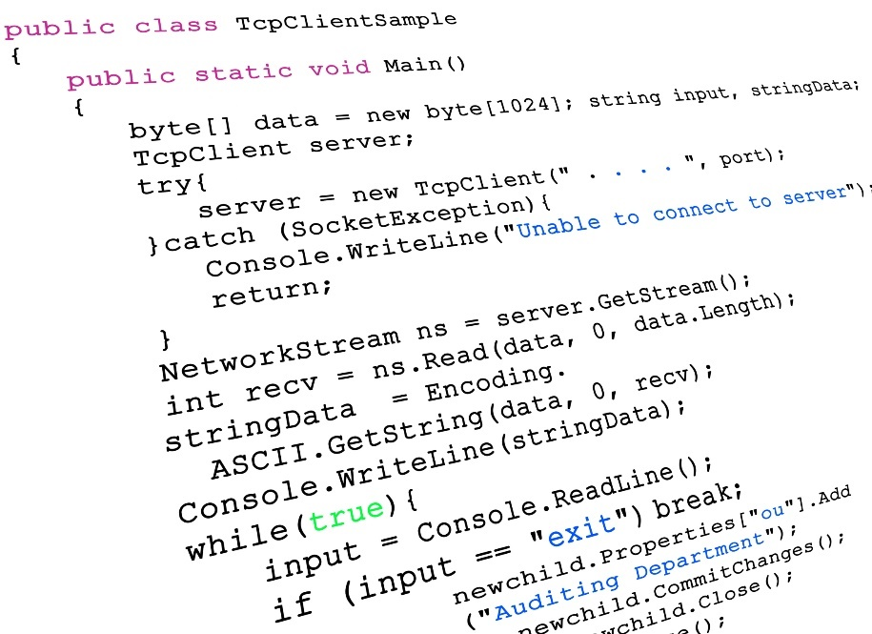

Programmability
Networking
Notes:
I would like to start by asking a question!

Slide 34
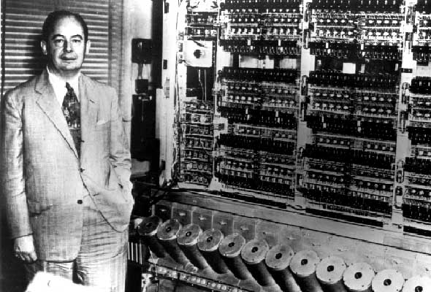
What makes computers programmable?

Slide 35
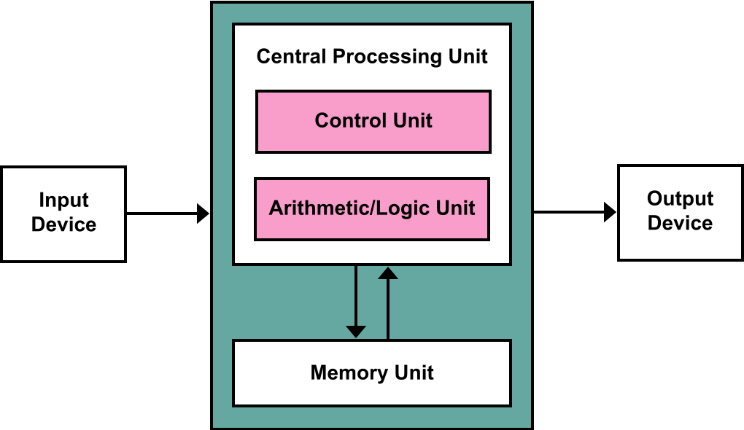
von Neumann architecture
General-purpose processors
Components
  Memory (RAM)
  Central processing
  unit (CPU)
    Control unit
    Arithmetic logic unit (ALU)
  Input/output system
Memory stores program and data
Program instructions execute sequentially

Slide 36
Programmability versus Efficiency

Slide 37
Programmability versus Efficiency
General-Purpose Processors
SIMD Units
Programmability
GPUs
FPGAs
ASICs
Efficiency

Slide 38


What is the difference between the computing industry and the paper towel industry?
Notes:
I would like to start by asking a question!

Slide 39

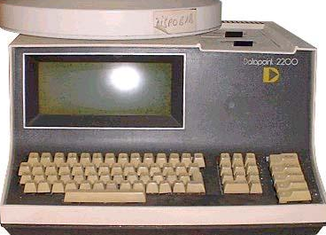
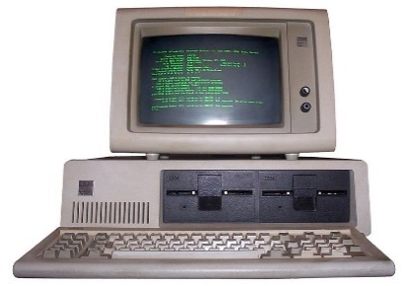



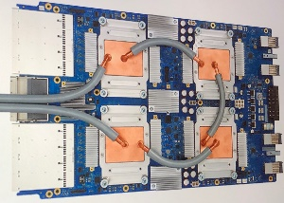
Industry of replacement
1971
2020
Industry of new possibilities
Notes:
The difference is we buy paper towels when we run out of them and we buy new computers because they get better!
We an industry of new possibilities and no and industry of replacement!

Slide 40
Can we continue being an industry of new possibilities?
Personalized
healthcare
Virtual
reality
Real-time
translators

Slide 41
Moore’s Law
Or, how we became an industry of new possibilities
Every 2 Years
Double the number of transistors
Build higher performance
general-purpose processors
  Make the transistors available to masses
  Increase performance (1.8×↑)
  Lower the cost of computing (1.8×↓)
Notes:
But, somebody needs to make those transistors available to the rest of the community.
All of this sounds nice and dandy, but what is the catch?

Slide 42
What is the catch?
Powering the transistors without melting the chip
Moore’s Law
W
W
Notes:
The catch is powering exponentially increasing number of transistors without melting the chip down.
As this graph shows even thought we have been doubling the number of transistors every year, but we have been increasing the chip power consumption much slower and actually we have already hit the chip power budget limits.

Slide 43
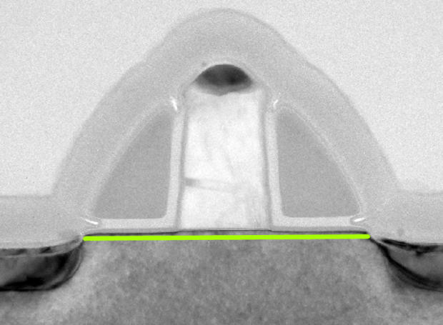
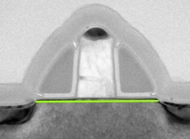
Dennard scaling:
Doubling the transistors; scale their power down
Transistor: 2D Voltage-Controlled Switch
Dimensions
Voltage
×0.7
Doping
Concentrations
Area
0.5×↓
Capacitance
0.7×↓
Frequency
1.4×↑
Power = Capacitance × Frequency × Voltage²
Power
0.5×↓
Notes:
In mid 2000 Dennard Scaling broke

Slide 44
Dennard scaling broke:
Double the transistors; still scale their power down
Transistor: 2D Voltage-Controlled Switch
Dimensions
Voltage
×0.7
Doping
Concentrations
Area
0.5×↓
Capacitance
0.7×↓
Frequency
1.4×↑
Power = Capacitance × Frequency × Voltage²
Power
0.5×↓
Notes:
So we had to do something in architecture to deal with the power problem!
Let’s lower the frequency and make the cores wimpier
Before I tell how these events overlap with the evolution of processors let me tell you about a side effect of this breakdown
Make all black! Add another big

Slide 45
Dark silicon
If you cannot power them, why bother making them?
Area
0.5×↓
Power
0.5×↓
Dark Silicon
Fraction of transistors that need to be
powered off at all times
due to power constraints
Notes:
This transistors that we cannot be powered on at all times have a low utility and cannot be transformed to performance easily!
All black not the red x
Initially, it is OK to have you can have a bunch of accelerators but it is not scalable solution

Slide 46
Looking back
Evolution of processors
Dennard scaling
broke
Single-core Era
Multicore Era
3.4 GHz
3.5 GHz
740 KHz
1971
2003
2013
2004
Notes:
The general consensus was that with exploiting parallelism in the applications and increasing the number of cores we can overcome the transistor scaling trends!
We will be able to continue scaling many more generations!
There was diminishing return but if the power
We didn’t have the power to spend a
We have shown how to
With a small cores but many of them you can exploit task level parallelism!
There is enormous value in improving the performance of single cores and in performance of multicore
Our community has largely moved to multicore a larger fration of the community outgh to be investigating other paths
Right now an enormous fraction of the researh community is invested in multicore research

Slide 47
How about Memory/DRAM?
Does it also have scaling issues?
What was DRAM trend over the last 30-40 years?

Slide 48
DRAM Scaling Challenge
Technology
Scaling
DRAM Cells
DRAM Cells
DRAM scaling enabled high capacity
Notes:
So now let’s see how we have achieved more memory in till now? The first DRAM chip had only a KB of memory, and now we can have gigabytes on memory in the system. For the last few decades technology scaling has enabled higher capacity. Similar to processor scaling, DRAM vendors have packed more cells in the same die area to achieve higher capacity at a lower cost. Now let’s see how DRAM chip capacity changed with technology scaling over the years.

Slide 49
DRAM Scaling Trend
2X/1.5 YEARS
2X/3 YEARS
DRAM scaling is getting difficult
Source: Flash Memory Summit 2013, Memcon 2014
Notes:
Here I show the trend of DRAM chip capacity over the years. In the x axis I show the year of mass production and in the y axis we have the capacity in megabits per chip. So in the last 30 years, chip capacity grown from 1 Mb to 8Gb. However, if we look at the growth, previously capacity used to double every two year, but the scaling trend has slowed down and capacity is doubling in every three years. It is very clear from the trend that DRAM scaling is getting difficult.

Slide 50
DRAM Scaling Challenge
Technology
Scaling
DRAM Cells
DRAM Cells
Manufacturing reliable cells at low cost
is getting difficult
Notes:
This is due to the fact that, as the cells are shrinking down there are more failures in DRAM cells and Manufacturing reliable cells at low cost in getting difficult.

Slide 51


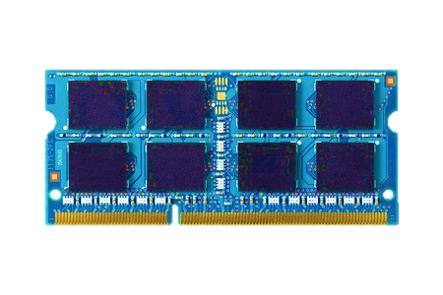
Traditional Approach
Make
DRAM
Reliable
Unreliable
DRAM Cells
Reliable
DRAM Cells
Reliable System
Manufacturing Time
System
in the Field
DRAM has strict reliability guarantee
Notes:
Traditional way to enable scaling is to use circuit-level optimizations and testing to to make sure every DRAM cell operates correctly. So when the chips are used in our systems, systems assumes that DRAM is error-free. Currently, Manufacturers have to provide a strict reliability guarantee for DRAMs.

Slide 52
New Approach
Make
DRAM
Reliable
Unreliable
DRAM Cells
Reliable
DRAM Cells
Reliable System
Manufacturing Time
Manufacturing Time
System
in the Field
System
in the Field
Shift the responsibility to systems
Notes:
instead of relying on the manufacturers, if the system becomes responsible for ensuring the reliability of the DRAM cells, manufactures can shrink the cells to smaller technology nodes without paying the cost for providing reliability guarantee. By shifting the responsibility of providing realizable DRAM operation from manufactures to systems, we can enable DRAM scaling.

Slide 53
System-Level Detection & Mitigation
Detect
and
Mitigate
Unreliable
DRAM Cells
Reliable System
Detect and mitigate errors after
the system has become operational
ONLINE PROFILING
Reduces cost, increases yield,
and enables scaling

Slide 54
Breaking the Abstraction
Problem
OS needs to know about testing and
tested pages
Need to implement the testing
in the hardware
Operating System
Need to know the circuit-level
characteristics of the failures
Architecture
Circuits
Samira Khan+, "The Efficacy of Error Mitigation Techniques for DRAM Retention Failures: A Comparative Experimental Study”, SIGMETRICS 2014

Slide 55
CSC 2224: Parallel Computer Architecture and Programming
Advice on Doing Research
Prof. Gennady Pekhimenko
University of Toronto
Fall 2020

Slide 56
Advancing Research & Development
We will talk a lot about this in this course
Learning by example
  Reading and evaluating strong and seminal papers
Learning by doing
  Semester-long research project
Learning by open, critical discussions
  Online discussion of papers & ideas on Piazza and Paper Reviews

Slide 57
What is the Goal of Research?
To generate new insight
  that can enable what previously did not exist
Research (in engineering) is a hunt for insight that can eventually impact the world

Slide 58
Basic Advice for Good RESEARCH
Choose great problems to solve: Have great taste
  Difficult
  Important
  High impact
Read heavily and critically
Think big (out of the box)
  Do not restrain yourself to tweaks
Aim high
Write and present really well

Slide 59

Looking here for lost keys

Slide 60
Lost keys here
Looking here

Slide 61

Current Architecture Practice

Slide 63
Aim Here
5-10 years

Slide 64
Enable this point
5-10 years

Slide 65
The Research Formula

Slide 66
Reward
If you are wildly successful, what difference will it make?

Slide 67
Effort
Learn as much as possible with as little work as possible

Slide 68
Effort
Do the minimum analysis and experimentation necessary to make a point

Slide 69
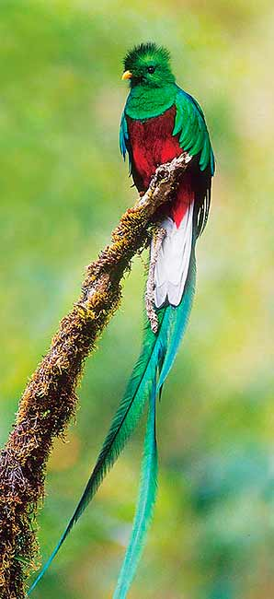
Research is a
hunt for insight
Need to get off the beaten path to find new insights

Slide 70
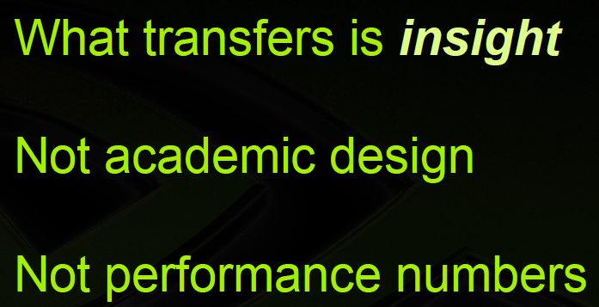

Recommended Talk
Bill Dally, Moving the needle: Effective Computer Architecture Research in Academy and Industry
ISCA 2010 Keynote Talk.
Acknowledgment: Past few slides are from this talk

Slide 71
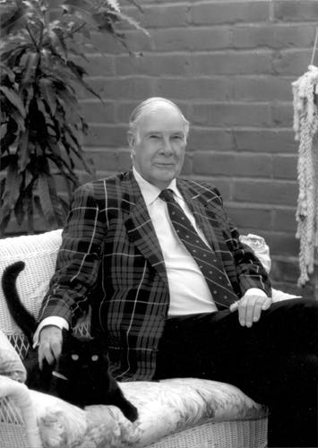
More Good Advice
“The purpose of computing is insight, not numbers”
Richard Hamming

Slide 72
CSC 2224: Parallel Computer Architecture and Programming
Introduction, Logistics
Prof. Gennady Pekhimenko
University of Toronto
Fall 2020

